Slide 1

XMLHttpRequest
Jon Friskics ©2012

Slide 2

XMLHttpRequest
  JavaScript object that can communicate with a server

Slide 3
  JavaScript is client-side script
    Client machine downloads script and executes it
  PHP is server-side script
    Server executes script and returns client-side code (HTML/CSS/JavaScript) for rendering
  XMLHttpRequest will sit in an already-downloaded client-side script and let that script communicate with the server
    Even better – it will do this without the BROWSER making a request!!! (aka page refresh)

Slide 4
XMLHttpRequest
  Step One – create an instance of the object
  Step Two – prepare and send your request to the server
  Step Three – process the response from the server

Slide 5
XMLHttpRequest
  Step One – create an instance of the object
    var xhr = new XMLHttpRequest();
    This works in Firefox because Firefox natively supports the XMLHttpRequest() object
      Webkit browsers support it too (Safari, Chrome)
      IE doesn’t always

Slide 6
XMLHttpRequest
  Step Two – prepare and send your request to the server
    onreadystatechange event handler
      Triggers when the readyState property changes
      if (xhr) {
      xhr.onreadystatechange = displayResponse;
      }
      (just like onclick triggers when a click event is received!)

Slide 7
XMLHttpRequest
  Step Two – prepare and send your request to the server
    open() method
      Replicates browser request
      Argument 1 – Browser specifies how request is sent
        Use GET if you aren’t sending any data
        Use POST if you are sending data
      Argument 2 – path to requested file
        Relative or absolute (to server, not www)
      Argument 3 – Boolean value
        true = asynchronous, false = synchronous
      Example
        xhr.open(“GET”, “my_file.txt”, true);

Slide 8
XMLHttpRequest
  Step Two – prepare and send your request to the server
    send() method
      Initiates open request
      Argument 1 – Data sent to server
        If method = GET, send(null);
        If method = POST,
  xhr.send(“attribute=value1+value2&attribute2=value3+value4”)

Slide 9
XMLHttpRequest
  Step Two – prepare and send your request to the server
    setRequestHeader() method
      Mimics the way browser sends headers with request
      Argument 1 – String that specifies the name of the header
      Argument 2 – String that specifies the value of the header
        If method = GET, no need to set headers
        If method = POST,
        xhr.setRequestHeader(“Content-type”, “application/x-www-form-urlencoded”);

Slide 10
XMLHttpRequest
  Steps One and Two combined
        var xhr = XMLHttpRequest();
        if (xhr) {
        xhr.onreadystatechange = function() {
        displayResponse(xhr);
        };
        xhr.open(“GET”, “my_file.txt”, true);
        xhr.send(null);
        }
    If the file “my_file.txt” exists in the same relative path, the above script will request the file asynchronously

Slide 11
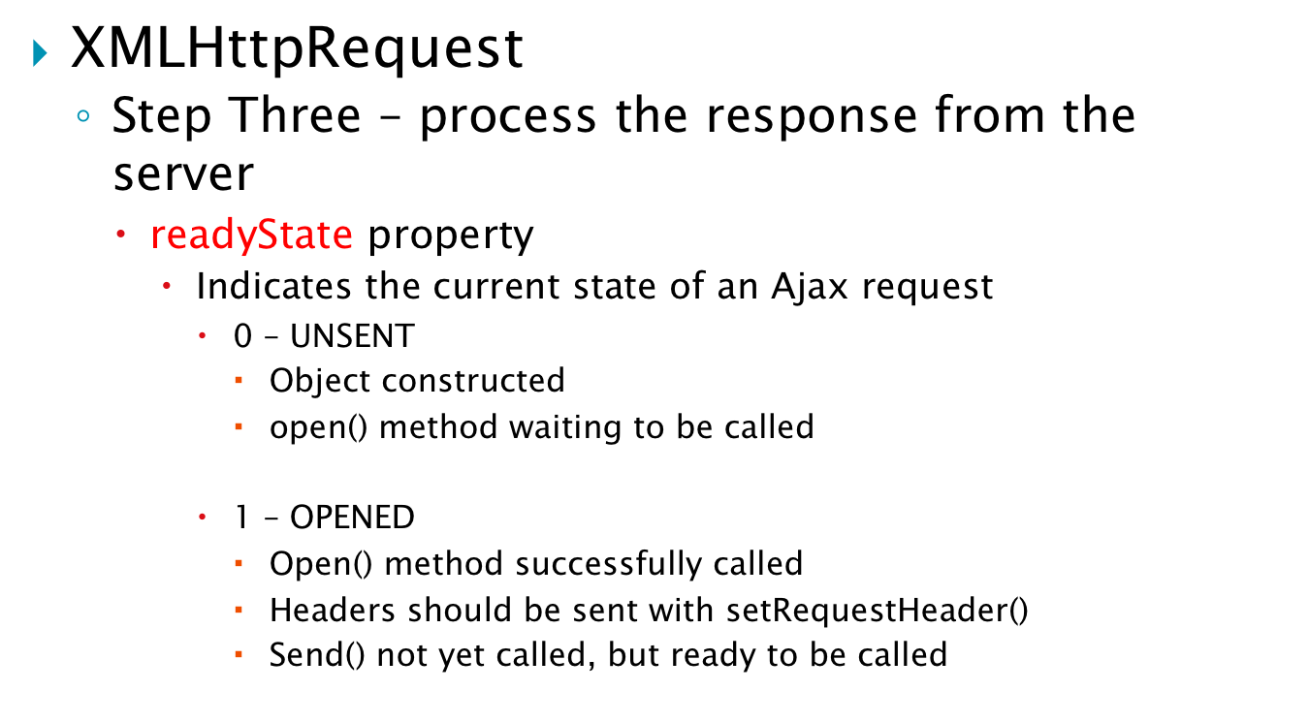

Slide 12
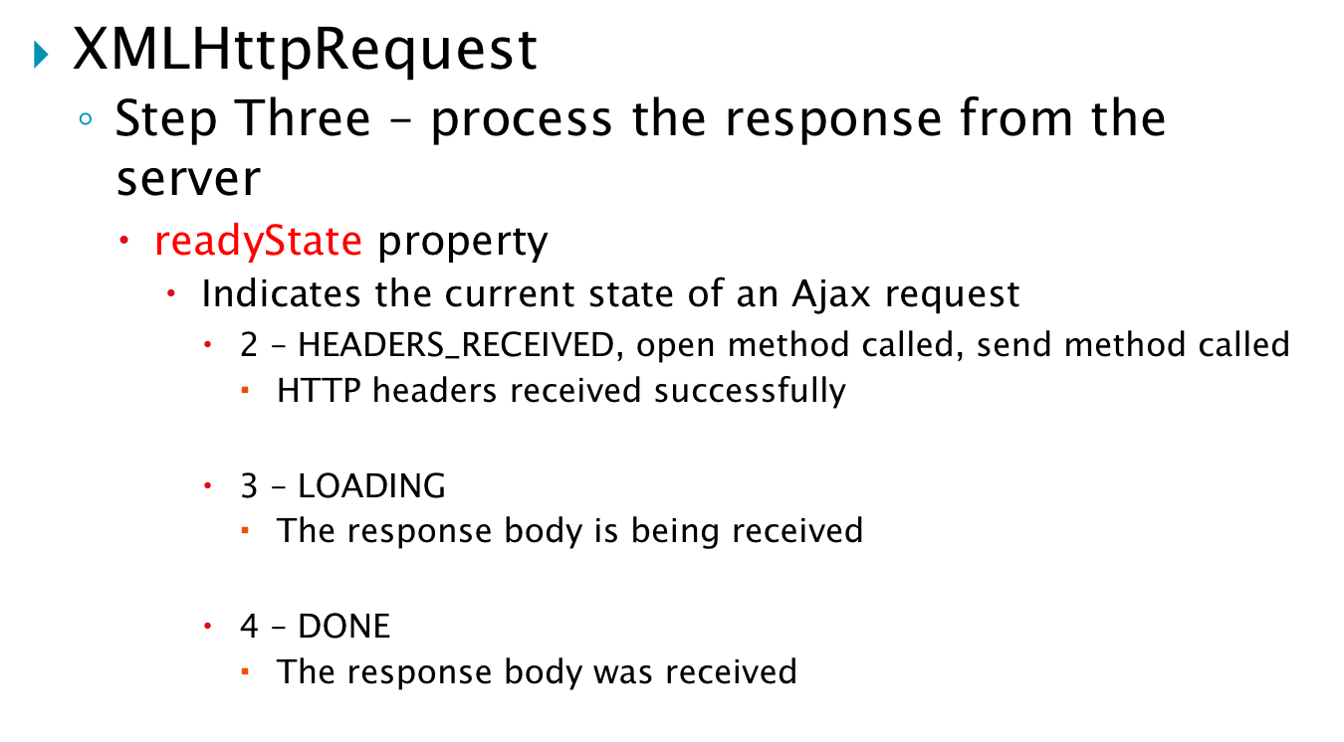

Slide 13
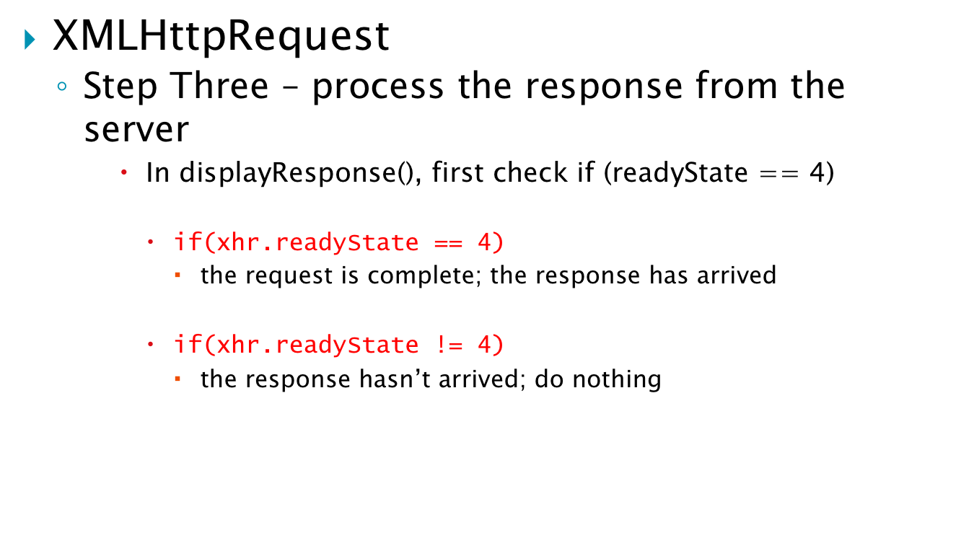

Slide 14
XMLHttpRequest
  Step Three – process the response from the server
    status property
      Indicates the current status of the request
      Sent as a header with each request
      http://en.wikipedia.org/wiki/List_of_HTTP_status_codes
      Example
        function displayResponse(xhr) {
        if (xhr.readyState == 4) {
        if (xhr.status == 200 || xhr.status == 304) {
        // do something with the response
        }
        }
        }

Slide 15
XMLHttpRequest
  Step Three – process the response from the server
    responseText property
      Contains String formatted data that was in the requested file
      Example
        function displayResponse(xhr) {
        if (xhr.readyState == 4) {
        if (xhr.status == 200 || xhr.status == 304) {
        console.log(xhr.responseText);
        }
        }
        }
  01-responseText example

Slide 16
A note about functions()
  You may have noticed that I did this:
      xhr.onreadystatechange = function() {
      displayResponse(xhr);
      };
  Instead of this:
      xhr.onreadystatechange = displayResponse(xhr);
  Why?

Slide 17
A note about functions()
  If you put () after a function name, the function will execute immediately, so:
      xhr.onreadystatechange = displayResponse(xhr);
      The onreadystatechange property now equals the result of the function called displayFunction that is passed the xhr object as an argument
      This doesn’t make any sense!

Slide 18
A note about functions()
  If you don’t put () after a function name, a reference to the function is created without the function executing
      xhr.onreadystatechange = displayResponse;
      This is valid and states “don’t call displayFunction until the readystatechange event fires and the onreadystatechange handler takes over”
      Problem: we can’t send any arguments

Slide 19
A note about functions()
  Solution: anonymous functions!
      var variable_name = function() {
        // stuff happening
      };
    Note that there is a semi-colon after the last curly bracket
      xhr.onreadystatechange = function() {
      displayResponse(xhr);
      };
      When the event handler is called, run an anonymous function that calls displayFunction() and sends the xhr object as an argument

Slide 20

Keith, Jeremy. Bulletproof Ajax. Berkeley: New Riders, 2007.
Axelson, Knute. coding: The Handbook for Information Technology. Chicago: Blue Line Press, 2005
http://www.w3.org/TR/XMLHttpRequest/. Accessed 01/17/12.

